Slide 1

IBM APPlied data science capstone project
Recommend the best location to start a business in Hanoi
By Linh Thuy Phung

Slide 2


contents
Introduction
Business problem
Target audience
Data
Methodology
Results
Summary
Discussion
Conclusion

Slide 3

Introduction
1
Introduction to the capstone project

Slide 4

Why choose Hanoi ?
Large networks
Government support
02
04
01
03
Center of culture and political
High-quality young labors

Slide 5

Business problem
THE PURPOSE OF THIS PROJECT
Starting a new business is never easy as it requires a thorough plan with so many factors to be taken into consideration. Among them, choosing a location is one of the most important decision. It especially arduous for foreigners who have little knowledge of the local destination. Therefore, the objective of this capstone project is to solve that specific task. In this project, we shall analyze data to select the most suitable location in Hanoi to open a business. Using data science knowledge, the project aims to explore geographical data of Hanoi, make visualization with map chart and marker and then, cluster venues into groups to find out which group is the best to locate a new business.

Slide 6

Title
TARGET AUDIENCE
DATA SECTION
Investors who are interested in opening a business in Hanoi, Vietnam, especially foreigners.
Local authorities could understand which part of the city is the most occupied with businesses to manage
Builders can seek the information of the most popular area to construct new building for renting
Other stakeholders
A list of all neighborhoods in Hanoi: from Wikipedia with BeautifulSoup: https://en.wikipedia.org/wiki/Category:Districts_of_Hanoi
The coordinate data of Hanoi city, including specific latitude and longitude of all neighborhoods: extracted by using Geocoder package
Data of venues around the neighborhoods in Hanoi: retrieved by using Foursquare API

Slide 7

Methodology
2
Methodology in the capstone project

Slide 8






Packages and libraries
Pandas: library for data analysis
Requests: library to handle requests
BeautifulSoup: library to parse HTML and XML documents
Geocoders: package to convert an address into latitude and longitude values
Matplotlib: library to plot chart
Foilum: map rendering library
Kmeans from sklearn: used for clustering venues

Slide 9
Step by step to the result
 | Neighborhood
0 | Ba Đình
1 | Ba Vì
2 | Bắc Từ Liêm
3 | Cầu Giấy
4 | Chương Mỹ
5 | Đan Phượng
6 | Đông Anh
7 | Đống Đa
8 | Gia Lâm
9 | Hà Đông
Step 1
Step 4
Step 2
Step 3
We shall use the link: https://en.wikipedia.org/wiki/Category:Districts_of_Hanoi from Wikipedia to extract the list of neighborhoods in Hanoi with Requests and BeautifulSoup. After that, a new dataframe will be created from the list using pandas library.

Slide 10
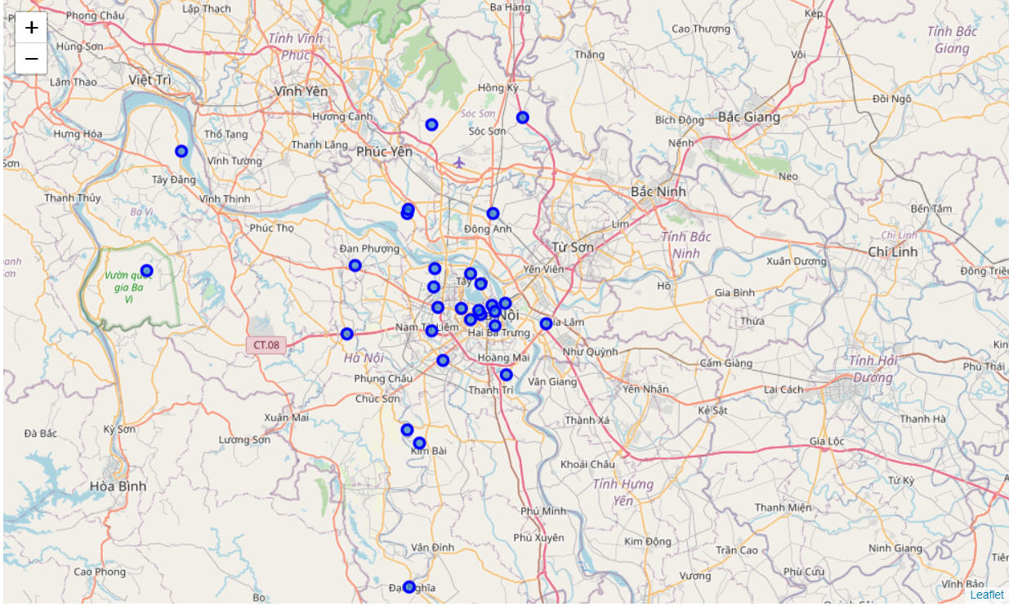
Step by step to the result
Most of neighborhoods are distributed around the center
=> There is a possibility that this area could be the ideal spot to attract more people
Step 1
Step 4
Step 2
Step 3
Pull off latitude and longitude of each neighborhood with Geocoder package.
Add them as new columns to the previous Dataframe.
Plot a map of Hanoi city with each neighborhood is presented as a marker

Slide 11
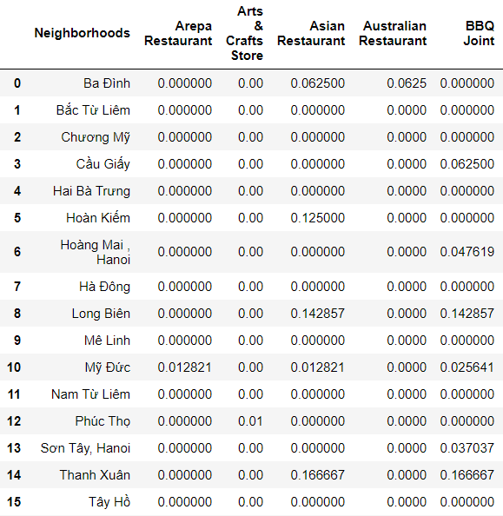
Step by step to the result
Step 1
Step 4
Step 2
Step 3
Get the top 100 venues (Venue name, Venue Latitude, Venue Longitude and Venue Category) that are within a radius of 500 meters by Foursquare API.
Check how many venues returned for each Neighborhood and find out how many unique categories can be curated from all the returned venues by using pandas
Group rows by neighborhood and taking the mean of the frequency of occurrence of each category

Slide 12
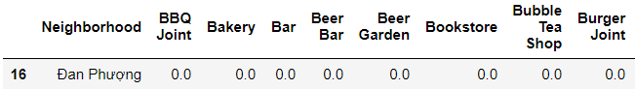
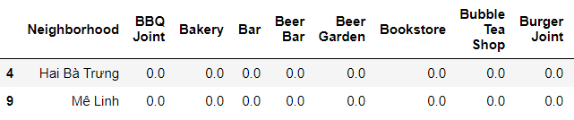
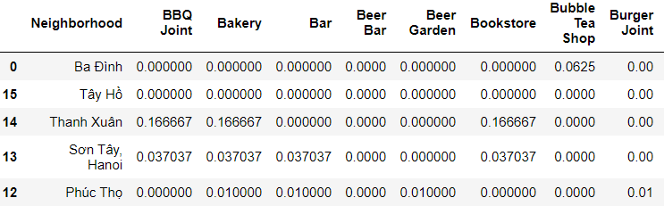
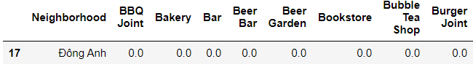
Step by step to the result
Cluster
1
Step 1
Step 4
Step 3
Cluster
2
Step 2
Finally, based on the above cleaned data, we will run k-means to cluster Hanoi into 4 clusters.
=> The results will allow us to identify which neighborhoods have higher concentration of businesses, and help us determine which area is the best location to open a business in Hanoi
Cluster
3
Cluster
4

Slide 13

results
3
Results of capstone project

Slide 14
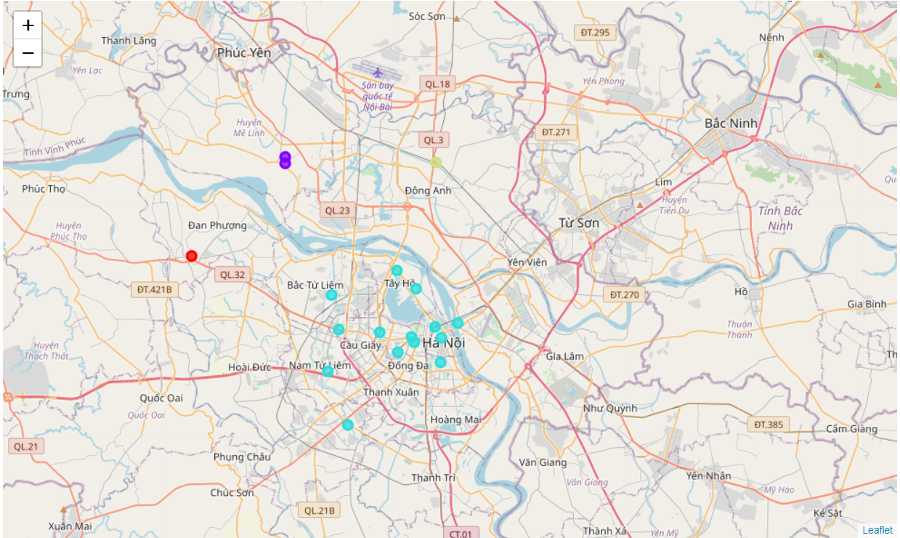
results
Cluster
0
Red markers
Neighborhoods with small to no existence of businesses.
Cluster
1
Violet markers
Neighborhoods with moderate number of businesses.
Cluster
2
Blue markers
Neighborhoods with large number of businesses.
Cluster
3
Yellow markers
Neighborhoods with small to no existence of businesses.
After running k-means to our data the results show that we classify neighborhoods into 4 clusters based on the frequency of occurrence
14

Slide 15

summary
4
Discussion and Conclusion

Slide 16



DISCUSS
CONCLUDE
According to the results, the cluster 2 will be the most suitable location to open a new business, because it has the highest frequency of occurrence of businesses. Normally, people want to avoid areas which are already populated due to high competition. However, it is not the case of Hanoi, instead, investors should do more research to find the unique business niche, since Hanoi is a rich cultural capital city, with many traditional jobs. Meanwhile, cluster 0, 1 and 3 are used to be agricultural land and now, part of them become factories. Hence, if you want to open a business in Hanoi, it is recommended to open office/headquarter in area of cluster 2 and place the factories in the remaining clusters
As observed from the map, cluster 2 has the largest number of businesses, while cluster 0 and cluster 3 have small to no existence of business, and cluster 1 only have a few businesses. From there, we suggest that cluster 2 to be the best location to open business if investors seek for a dynamic area to try something new and unique. At the same time, the remaining areas also should be exploited to place factories or plant natural resources. In the end, the project only gives an overview of the area to suggest the most suitable location, but neglecting many other factors. Therefore, future research based on this result should be conducted with more factors involved to overcome limitations of this project

Slide 17

THANK YOU

